Slide 1
2022 PRC Community Health Needs Assessment
Cass County, Indiana
Bruce Lockwood
Senior Vice President, Community Health

Slide 2
Community Health Needs Assessment
The PRC Community Health Needs Assessment consists of both primary and secondary data.
BENCHMARKING
Previous Survey Data
PRC National Health Survey
Indiana BRFSS data
Healthy People 2030 targets
National vital statistics data
Secondary Data
County-level data
Census data, vital statistics, other health-related data
Online Key Informant Survey
Community stakeholder input — 90 physicians, public health, other health providers, social services, community leaders
Based on their experiences, the populations they serve
Customized Local Health Survey
Population-based
Targets health status, experience, behaviors
Conducted via landline/cell phones

Slide 3
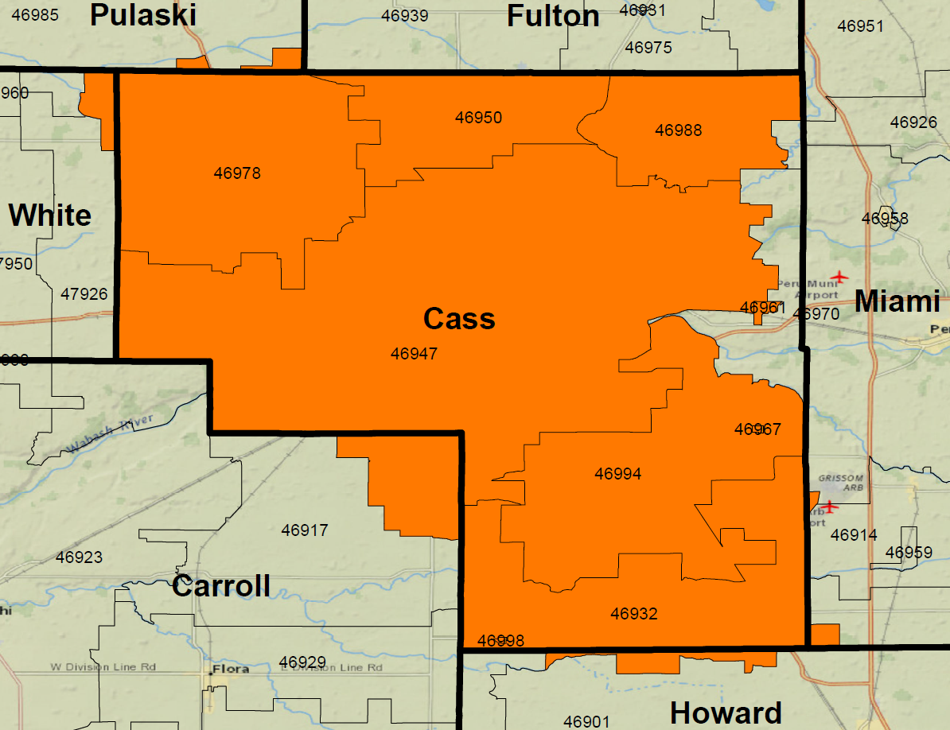
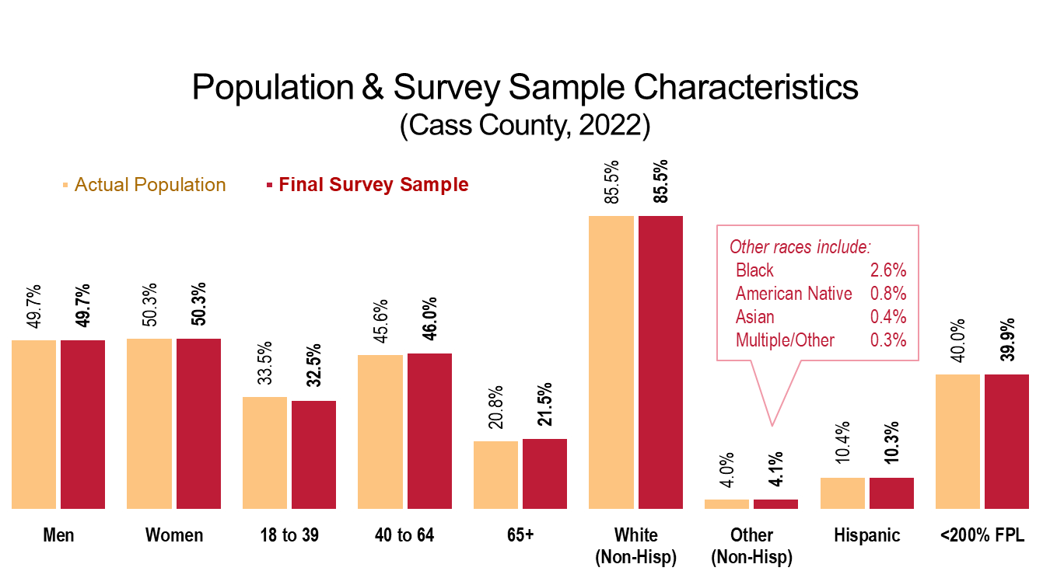
Population Survey
500 surveys across Cass County.
Final sample weighted in proportion to total population
Over 125 survey items; 25-30 minute interview.
Total sample size gives an overall maximum confidence interval of ± 4.4%.

Slide 4
Today’s Activities
Presentation
Represents just a fraction of the data collected through this assessment.
Primarily focuses on areas of need ("Areas of Opportunity"); however, there were many positive findings for the area as well.
Will allow for Q&A at the end.
Prioritization
During the second half of our meeting, you will be asked to rank health issues along various criteria to inform the prioritization process.

Slide 5
Key Informant Input

Slide 6
Key Informants: Top Health Issues Identified as “Major Problems” in the Community

Slide 7
General Health Status
Areas of Opportunity
Access to Health Services
Cancer
Diabetes
Heart Disease & Stroke
Infant Health & Family Planning
Injury & Violence
Mental Health
Nutrition, Physical Activity & Weight
Potentially Disabling Conditions
Respiratory Diseases
Septicemia
Substance Abuse
Tobacco Use
Q & A
Today, we will primarily focus on 13 areas of need ("Areas of Opportunity"); however, there were many positive findings for the community in our assessment as well

Slide 8
General Health Status
Areas of Opportunity
Access to Health Services
Cancer
Diabetes
Heart Disease & Stroke
Infant Health & Family Planning
Injury & Violence
Mental Health
Nutrition, Physical Activity & Weight
Potentially Disabling Conditions
Respiratory Diseases
Septicemia
Substance Abuse
Tobacco Use
Q & A

Slide 9
Self-Reported Health Status (Cass County, 2022)
Sources: ● 2022 PRC Community Health Survey, PRC, Inc. [Item 5]
Notes: ● Asked of all respondents.

Slide 10
Experience “Fair” or “Poor” Overall Health
Cass County
Sources: ● 2022 PRC Community Health Survey, PRC, Inc. [Item 5]
● Behavioral Risk Factor Surveillance System Survey Data. Atlanta, Georgia. United States Department of Health and Human Services, Centers for Disease Control and Prevention (CDC): 2021 Indiana data.
● 2020 PRC National Health Survey, PRC, Inc.
Notes: ● Asked of all respondents.

Slide 11
Experience “Fair” or “Poor” Overall Health (Cass County, 2022)
Sources: ● 2022 PRC Community Health Survey, PRC, Inc. [Item 5]
Notes: ● Asked of all respondents.

Slide 12
General Health Status
Areas of Opportunity
Access to Health Services
Cancer
Diabetes
Heart Disease & Stroke
Infant Health & Family Planning
Injury & Violence
Mental Health
Nutrition, Physical Activity & Weight
Potentially Disabling Conditions
Respiratory Diseases
Septicemia
Substance Abuse
Tobacco Use
Q & A

Slide 13
Lack of Health Care Insurance Coverage (Adults Age 18-64) Healthy People 2030 = 7.9% or Lower
Cass County
Sources: ● 2022 PRC Community Health Survey, PRC, Inc. [Item 169]
● Behavioral Risk Factor Surveillance System Survey Data. Atlanta, Georgia. United States Department of Health and Human Services, Centers for Disease Control and Prevention (CDC): 2021 Indiana data.
● 2020 PRC National Health Survey, PRC, Inc.
● US Department of Health and Human Services. Healthy People 2030. August 2020. http://www.healthypeople.gov
Notes: ● Asked of all respondents under the age of 65.

Slide 14
Barriers to Access Have Prevented Medical Care in the Past Year
Significantly higher than found in 2013
Significantly higher than found in 2013
Significantly higher than found in 2013
Significantly higher than found in 2013
Sources: ● 2022 PRC Community Health Survey, PRC, Inc. [Items 7-14]
● 2020 PRC National Health Survey, PRC, Inc.
Notes: ● Asked of all respondents.
In all, 43.8% of Cass County adults encountered one or more of these barriers in the past year.

Slide 15
Have a Specific Source of Ongoing Medical Care Healthy People 2030 = 84.0% or Higher
Have Used a Hospital Emergency Room More Than Once in the Past Year
Sources: ● 2022 PRC Community Health Survey, PRC, Inc. [Item 170]
● 2020 PRC National Health Survey, PRC, Inc.
● US Department of Health and Human Services. Healthy People 2030. August 2020. http://www.healthypeople.gov
Notes: ● Asked of all respondents.
Notes:
Cass County only has 22 primary care physicians, which as a ratio is much lower than IN & US.

Slide 16
General Health Status
Areas of Opportunity
Access to Health Services
Cancer
Diabetes
Heart Disease & Stroke
Infant Health & Family Planning
Injury & Violence
Mental Health
Nutrition, Physical Activity & Weight
Potentially Disabling Conditions
Respiratory Diseases
Septicemia
Substance Abuse
Tobacco Use
Q & A

Slide 17
Leading Causes of Death (Cass County, 2020)
Sources: ● CDC WONDER Online Query System. Centers for Disease Control and Prevention, Epidemiology Program Office, Division of Public Health Surveillance and Informatics. Data extracted June 2022.
Notes: ● Lung disease is CLRD, or chronic lower respiratory disease.
Notes:
Age-adjusted cancer death rate is overall much higher than the US rate.
By cancer sites, lung cancer rates are comparatively high for both deaths and incidence (new cases diagnosed each year).

Slide 18
Breast Cancer Screening
(Women Age 50-74) Healthy People 2030 = 77.1% or Higher
Cervical Cancer Screening
(Women Age 21-65) Healthy People 2030 = 84.3% or Higher
Colorectal Cancer Screening
(All Adults Age 50-75) Healthy People 2030 = 74.4% or Higher
Sources: ● 2022 PRC Community Health Survey, PRC, Inc. [Items 133, 134, 137]
● Behavioral Risk Factor Surveillance System Survey Data. Atlanta, Georgia. United States Department of Health and Human Services, Centers for Disease Control and Prevention (CDC): 2021 Indiana data.
● 2020 PRC National Health Survey, PRC, Inc.
● US Department of Health and Human Services. Healthy People 2030. August 2020. http://www.healthypeople.gov
Notes: ● Each indicator is shown among the gender and/or age group specified.

Slide 19
General Health Status
Areas of Opportunity
Access to Health Services
Cancer
Diabetes
Heart Disease & Stroke
Infant Health & Family Planning
Injury & Violence
Mental Health
Nutrition, Physical Activity & Weight
Potentially Disabling Conditions
Respiratory Diseases
Septicemia
Substance Abuse
Tobacco Use
Q & A

Slide 20
Diabetes:
Age-Adjusted Mortality (Annual Average Deaths per 100,000 Population)
Kidney Disease:
Age-Adjusted Mortality (Annual Average Deaths per 100,000 Population)
Sources: ● CDC WONDER Online Query System. Centers for Disease Control and Prevention, Epidemiology Program Office, Division of Public Health Surveillance and Informatics. Data extracted June 2022.

Slide 21
Prevalence of Diabetes (Cass County, 2022)
Sources: ● 2022 PRC Community Health Survey, PRC, Inc. [Items 37, 140]
Notes: ● Asked of all respondents.
● Excludes gestational diabetes (occurring only during pregnancy).
Notes:
The prevalence of kidney disease has increased over the past 6 years.

Slide 22
General Health Status
Areas of Opportunity
Access to Health Services
Cancer
Diabetes
Heart Disease & Stroke
Infant Health & Family Planning
Injury & Violence
Mental Health
Nutrition, Physical Activity & Weight
Potentially Disabling Conditions
Respiratory Diseases
Septicemia
Substance Abuse
Tobacco Use
Q & A

Slide 23
Leading Causes of Death (Cass County, 2020)
Sources: ● CDC WONDER Online Query System. Centers for Disease Control and Prevention, Epidemiology Program Office, Division of Public Health Surveillance and Informatics. Data extracted June 2022.
Notes: ● Lung disease is CLRD, or chronic lower respiratory disease.
Notes:
9.6% of Cass County residents report having heart disease (significantly higher than US).

Slide 24
Prevalence of
High Blood Pressure Healthy People 2030 = 27.7% or Lower
Prevalence of
High Blood Cholesterol
Sources: ● 2022 PRC Community Health Survey, PRC, Inc. [Items 41, 44, 129, 130]
● Behavioral Risk Factor Surveillance System Survey Data. Atlanta, Georgia. United States Department of Health and Human Services, Centers for Disease Control and Prevention (CDC): 2021 Indiana data.
● 2020 PRC National Health Survey, PRC, Inc.
● US Department of Health and Human Services. Healthy People 2030. August 2020. http://www.healthypeople.gov
Notes: ● Asked of all respondents.

Slide 25
Present One or More Cardiovascular Risks or Behaviors (Cass County, 2022)
Sources: ● 2022 PRC Community Health Survey, PRC, Inc. [Item 131]
Notes: ● Reflects all respondents.
● Cardiovascular risk is defined as exhibiting one or more of the following: 1) no leisure-time physical activity; 2) regular/occasional cigarette smoking; 3) high blood pressure; 4) high blood cholesterol; and/or 5) being overweight/obese.
Notes:
All CV risk factors: HBP/HBC, not getting enough physical activity, smoking cigarettes, or being overweight/obese….

Slide 26
General Health Status
Areas of Opportunity
Access to Health Services
Cancer
Diabetes
Heart Disease & Stroke
Infant Health & Family Planning
Injury & Violence
Mental Health
Nutrition, Physical Activity & Weight
Potentially Disabling Conditions
Respiratory Diseases
Septicemia
Substance Abuse
Tobacco Use
Q & A
Notes:
One slide to share…

Slide 27
Infant Mortality Rate (Annual Average Infant Deaths per 1,000 Live Births, 2016-2020) Healthy People 2030 = 5.0 or Lower
Teen Birth Rate (Births to Adolescents Age 15-19 per 1,000 Females Age 15-19, 2014-2020)
Sources: ● CDC WONDER Online Query System. Centers for Disease Control and Prevention, National Center for Health Statistics, Division of Vital Statistics.
Data extracted June 2022.
● US Department of Health and Human Services. Healthy People 2030. August 2020. http://www.healthypeople.gov
Notes: ● Infant deaths include deaths of children under 1 year old.
● This indicator is relevant because high rates of infant mortality indicate the existence of broader issues pertaining to access to care and maternal and child health.

Slide 28
General Health Status
Areas of Opportunity
Access to Health Services
Cancer
Diabetes
Heart Disease & Stroke
Infant Health & Family Planning
Injury & Violence
Mental Health
Nutrition, Physical Activity & Weight
Potentially Disabling Conditions
Respiratory Diseases
Septicemia
Substance Abuse
Tobacco Use
Q & A

Slide 29
Unintentional Injuries: Age-Adjusted Mortality Trends (Annual Average Deaths per 100,000 Population) Healthy People 2030 = 43.2 or Lower
Sources: ● CDC WONDER Online Query System. Centers for Disease Control and Prevention, Epidemiology Program Office, Division of Public Health Surveillance and Informatics. Data extracted June 2022.
● US Department of Health and Human Services. Healthy People 2030. August 2020. http://www.healthypeople.gov
Notes:
Worse than 2011 and IN+US

Slide 30
Leading Causes of Unintentional Injury Deaths (Cass County, 2018-2020)
Sources: ● CDC WONDER Online Query System. Centers for Disease Control and Prevention, Epidemiology Program Office, Division of Public Health Surveillance and Informatics. Data extracted June 2022.
Notes:
Note: in our survey, 36.6% of Cass County adults aged 45 or older reported falling one or more times in the past year (compared to 27.5% nationally).

Slide 31
Have Ever Been Hit, Slapped, Pushed, Kicked, or Hurt in Any Way by an Intimate Partner
Cass County
Sources: ● 2022 PRC Community Health Survey, PRC, Inc. [Item 47]
● 2020 PRC National Health Survey, PRC, Inc.
Notes: ● Asked of all respondents.
Notes:
In terms of violence…

Slide 32
General Health Status
Areas of Opportunity
Access to Health Services
Cancer
Diabetes
Heart Disease & Stroke
Infant Health & Family Planning
Injury & Violence
Mental Health
Nutrition, Physical Activity & Weight
Potentially Disabling Conditions
Respiratory Diseases
Septicemia
Substance Abuse
Tobacco Use
Q & A

Slide 33
Mental Health Indicators
Experience “Fair” or “Poor” Mental Health
Have Been Diagnosed With a Depressive Disorder
Have Experienced Symptoms of Chronic Depression
Sources: ● 2022 PRC Community Health Survey, PRC, Inc. [Item 90]
● 2020 PRC National Health Survey, PRC, Inc.
Notes: ● Asked of all respondents.
Notes:
“Fair/poor” mental health is significantly above national findings (others shown are similar).
We’ve also seen and increase in perceptions of stress levels on a typical day (although most notably between 2016 and 2019).
Demographically, women, younger adults, and lower-income residents appear to be a greater risk.

Slide 34
Suicide: Age-Adjusted Mortality Trends (Annual Average Deaths per 100,000 Population) Healthy People 2030 = 12.8 or Lower
Sources: ● CDC WONDER Online Query System. Centers for Disease Control and Prevention, Epidemiology Program Office, Division of Public Health Surveillance and Informatics. Data extracted June 2022.
● US Department of Health and Human Services. Healthy People 2030. August 2020. http://www.healthypeople.gov
Notes:
Much higher than 2011

Slide 35
General Health Status
Areas of Opportunity
Access to Health Services
Cancer
Diabetes
Heart Disease & Stroke
Infant Health & Family Planning
Injury & Violence
Mental Health
Nutrition, Physical Activity & Weight
Potentially Disabling Conditions
Respiratory Diseases
Septicemia
Substance Abuse
Tobacco Use
Q & A

Slide 36
Prevalence of Total Overweight (Overweight and Obese)
Prevalence of Obesity Healthy People 2030 = 36.0% or Lower
Sources: ● 2022 PRC Community Health Survey, PRC, Inc. [Items 154-156]
● Behavioral Risk Factor Surveillance System Survey Data. Atlanta, Georgia. United States Department of Health and Human Services, Centers for Disease Control and Prevention (CDC): 2021 Indiana data.
● 2020 PRC National Health Survey, PRC, Inc.
Notes: ● Based on reported heights and weights, asked of all respondents.
● The definition of overweight is having a body mass index (BMI), a ratio of weight to height (kilograms divided by meters squared), greater than or equal to 25.0, regardless of gender. The definition for obesity is a BMI greater than or equal to 30.0.

Slide 37
Prevalence of Obesity (Cass County, 2022) Healthy People 2030 = 36.0% or Lower
Cass County
Sources: ● 2022 PRC Community Health Survey, PRC, Inc. [Item 154]
● US Department of Health and Human Services. Healthy People 2030. August 2020. http://www.healthypeople.gov
Notes: ● Based on reported heights and weights, asked of all respondents.
● The definition of obesity is having a body mass index (BMI), a ratio of weight to height (kilograms divided by meters squared), greater than or equal to 30.0, regardless of gender.
Notes:
Prevalence of obesity in children has also increased significantly from 2013 findings and is higher than found nationally.

Slide 38
Find It “Very” or “Somewhat” Difficult to Buy Affordable Fresh Produce (Cass County, 2022)
Cass County
Sources: ● 2022 PRC Community Health Survey, PRC, Inc. [Item 86]
Notes: ● Asked of all respondents.
Notes:
Also: fruit/vegetable consumption is lower than the US. Even lower among low income and communities of color.

Slide 39
General Health Status
Areas of Opportunity
Access to Health Services
Cancer
Diabetes
Heart Disease & Stroke
Infant Health & Family Planning
Injury & Violence
Mental Health
Nutrition, Physical Activity & Weight
Potentially Disabling Conditions
Respiratory Diseases
Septicemia
Substance Abuse
Tobacco Use
Q & A

Slide 40
Prevalence of Potentially Disabling Conditions
Sources: ● 2022 PRC Community Health Survey, PRC, Inc. [Items 26, 141-142]
● 2020 PRC National Health Survey, PRC, Inc.
● US Department of Health and Human Services. Healthy People 2030. August 2020. http://www.healthypeople.gov
Notes: ● The sciatica indicator reflects the total sample of respondents; the arthritis and osteoporosis columns reflect adults age 50+.
26.0% of residents are limited in activities in some way due to a physical, mental, or emotional problem (19.2% in 2013).

Slide 41
Currently Have Three or More Chronic Conditions (Cass County, 2022)
Sources: ● 2022 PRC Community Health Survey, PRC, Inc. [Item 143]
Notes: ● Asked of all respondents.
● In this case, chronic conditions include lung disease, arthritis, sciatica, cancer, osteoporosis, kidney disease, heart attack/angina, stroke, asthma, high blood pressure, high blood cholesterol, diabetes, obesity, and/or diagnosed depression.

Slide 42
Alzheimer's Disease: Age-Adjusted Mortality Trends (Annual Average Deaths per 100,000 Population)
Sources: ● CDC WONDER Online Query System. Centers for Disease Control and Prevention, Epidemiology Program Office, Division of Public Health Surveillance and Informatics. Data extracted June 2022.

Slide 43
General Health Status
Areas of Opportunity
Access to Health Services
Cancer
Diabetes
Heart Disease & Stroke
Infant Health & Family Planning
Injury & Violence
Mental Health
Nutrition, Physical Activity & Weight
Potentially Disabling Conditions
Respiratory Diseases
Septicemia
Substance Abuse
Tobacco Use
Q & A

Slide 44
COVID-19: Age-Adjusted Mortality (2020 Annual Average Deaths per 100,000 Population)
Chronic Lower Respiratory Disease: Age-Adjusted Mortality (2018-2020 Annual Average Deaths per 100,000 Population)
Sources: ● CDC WONDER Online Query System. Centers for Disease Control and Prevention, Epidemiology Program Office, Division of Public Health Surveillance and Informatics. Data extracted June 2022.
Notes:
CLRD includes conditions like emphysema and chronic bronchitis.

Slide 45
Prevalence of
Adults With Asthma
Prevalence of Chronic Obstructive Pulmonary Disease (COPD)
currently higher in Cass County than IL & US
Sources: ● 2022 PRC Community Health Survey, PRC, Inc. [Item 138]
Notes: ● Asked of all respondents.
● Includes those who have ever been diagnosed with asthma and report that they still have asthma.

Slide 46
General Health Status
Areas of Opportunity
Access to Health Services
Cancer
Diabetes
Heart Disease & Stroke
Infant Health & Family Planning
Injury & Violence
Mental Health
Nutrition, Physical Activity & Weight
Potentially Disabling Conditions
Respiratory Diseases
Septicemia
Substance Abuse
Tobacco Use
Q & A

Slide 47
Septicemia: Age-Adjusted Mortality Trends (Annual Average Deaths per 100,000 Population)
Sources: ● CDC WONDER Online Query System. Centers for Disease Control and Prevention, Epidemiology Program Office, Division of Public Health Surveillance and Informatics. Data extracted June 2022.
Notes:
Trending downward, but historically high…

Slide 48
General Health Status
Areas of Opportunity
Access to Health Services
Cancer
Diabetes
Heart Disease & Stroke
Infant Health & Family Planning
Injury & Violence
Mental Health
Nutrition, Physical Activity & Weight
Potentially Disabling Conditions
Respiratory Diseases
Septicemia
Substance Abuse
Tobacco Use
Q & A

Slide 49
Illicit Drug Use in the Past Month Healthy People 2030 = 12.0% or Lower
Cass County
Sources: ● 2022 PRC Community Health Survey, PRC, Inc. [Item 59]
● 2020 PRC National Health Survey, PRC, Inc.
● US Department of Health and Human Services. Healthy People 2030. August 2020. http://www.healthypeople.gov
Notes: ● Asked of all respondents.
Notes:
Demographically, higher among under 65 and White resident

Slide 50
Life Has Been Negatively Affected by Substance Abuse (by Self or Someone Else) (Cass County, 2022)
Sources: ● 2022 PRC Community Health Survey, PRC, Inc. [Item 61]
Notes: ● Asked of all respondents.
● Includes response of “a great deal,” “somewhat,” and “a little.”

Slide 51
General Health Status
Areas of Opportunity
Access to Health Services
Cancer
Diabetes
Heart Disease & Stroke
Infant Health & Family Planning
Injury & Violence
Mental Health
Nutrition, Physical Activity & Weight
Potentially Disabling Conditions
Respiratory Diseases
Septicemia
Substance Abuse
Tobacco Use
Q & A

Slide 52
Tobacco Use
Currently Smoke Cigarettes
Currently Use Vaping Products
Sources: ● 2022 PRC Community Health Survey, PRC, Inc. [Item 40]
Notes: ● Asked of all respondents.
Recall that tobacco use was a Top 5 concern among key informants.
Notes:
Each is similar to IN and US, and has not changed dramatically … however, more than 1 out of 4 adults 40-64 smoke as do more than 1 out of 4 at lower incomes. Vaping is more prevalent in young adults and in communities of color.
Also, keep in mind that Tobacco Use was a top concern among the key informants we surveyed.

Slide 53
General Health Status
Areas of Opportunity
Access to Health Services
Cancer
Diabetes
Heart Disease & Stroke
Infant Health & Family Planning
Injury & Violence
Mental Health
Nutrition, Physical Activity & Weight
Potentially Disabling Conditions
Respiratory Diseases
Septicemia
Substance Abuse
Tobacco Use
Q & A

Slide 54
Prioritization

Slide 55
Prioritization Exercise
For each of the health issues, you will assign two scores:
Scope & Severity — How big is the problem?
How many people are affected?
How do we compare to state or national data?
To what degree does this lead to death or disability, impair quality of life, or impact other health issues?
Ability to Impact — Can we make a difference?
What is the likelihood of having a positive impact on this health issue?
This should reflect collaborative efforts between health care and other organizations in the community.

Slide 56
Mental Health
Access to Health Care Services
Substance Abuse
Infant Health & Family Planning
Nutrition, Physical Activity & Weight
Diabetes
Heart Disease & Stroke
Cancer
Tobacco Use
Respiratory Disease
Injury & Violence
Potentially Disabling Conditions
Septicemia

Slide 57
Next Steps

Slide 58
Implementation Plan
Implementation Planning Meeting
Wednesday, September 28
1:30 pm – 3:30 pm
Ivy Tech - Logansport

Slide 59
Thank You!
PRC, Inc.
Bruce Lockwood
Senior Vice President, Community Health
www.PRCCustomResearch.com

