Slide 1
Cass County, Indiana
Community Health Findings
Prepared for
By Professional Research Consultants, Inc.

Slide 2
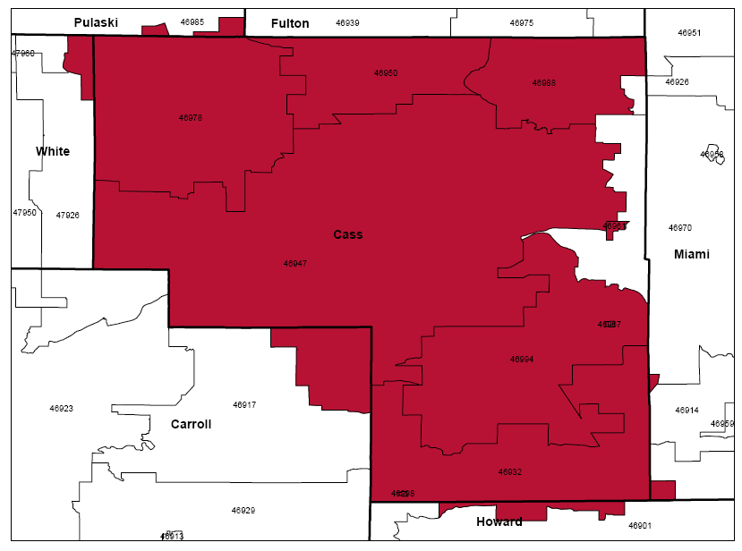
Customized Local PRC Community Health Survey
Surveys among 400 adults in Cass County, Indiana
Random distribution
144 survey items; 25-30 minute interview
±4.9% max error overall
BENCHMARKING
PRC National Health Survey
State BRFSS data
Healthy People 2020 targets
PRC Community Health Needs Assessment
Secondary
Data
Key Informant
Focus Groups
National vital statistics data
Four Key Informant Focus Groups, comprised of 16 community stakeholders:
Public health, physicians & other health providers
Social services & other community leaders

Slide 3
Population & Sample Characteristics (Cass County, 2013)
Sources: ● Census 2010, Summary File 3 (SF 3). U.S. Census Bureau.
● 2013 PRC Community Health Survey, Professional Research Consultants, Inc.

Slide 4
This Presentation
Represents just a fraction of the data collected through this assessment.
Focuses on areas of need; however, there were many positive findings for the region as well.
Will allow for Q&A at the end.

Slide 5
General Health Status
Areas of Opportunity
Access to Health Services
Cancer
Diabetes
Heart Disease & Stroke
Injury & Violence
Maternal, Infant & Child Health
Mental Health & Mental Disorders
Nutrition, Physical Activity & Weight
Oral Health
Respiratory Disease
Tobacco Use
Next Steps

Slide 6
General Health Status
Areas of Opportunity
Access to Health Services
Cancer
Diabetes
Heart Disease & Stroke
Injury & Violence
Maternal, Infant & Child Health
Mental Health & Mental Disorders
Nutrition, Physical Activity & Weight
Oral Health
Respiratory Disease
Tobacco Use
Next Steps

Slide 7
Self-Reported Health Status (Cass County, 2013)
“Would you say that, in general, your health is excellent, very good, good, fair or poor?”
“Fair/Poor” = 12.5%
“Excellent/Very Good” = 46.3%
Sources: ● 2013 PRC Community Health Survey, Professional Research Consultants, Inc. [Item 5]
Notes: ● Asked of all respondents.
Notes:
% "Fair/Poor" Physical Health

Slide 8
Experience “Fair” or “Poor” Overall Health
Sources: ● 2013 PRC Community Health Survey, Professional Research Consultants, Inc. [Item 5]
● Behavioral Risk Factor Surveillance System Survey Data. Atlanta, Georgia. United States Department of Health and Human Services, Centers for Disease Control
and Prevention (CDC): 2011 Indiana data.
● 2011 PRC National Health Survey, Professional Research Consultants, Inc.
Notes: ● Asked of all respondents.
Notes:
% "Fair/Poor" Physical Health

Slide 9
Experience “Fair” or “Poor” Overall Health (Cass County, 2013)
Sources: ● 2013 PRC Community Health Survey, Professional Research Consultants, Inc. [Item 5]
Notes: ● Asked of all respondents.
● Income categories reflect respondent's household income as a ratio to the federal poverty level (FPL) for their household size. “Low Income” includes households
with incomes up to 200% of the federal poverty level; “Mid/High Income” includes households with incomes at 200% or more of the federal poverty level.
Notes:
% "Fair/Poor" Physical Health

Slide 10
General Health Status
Areas of Opportunity
Access to Health Services
Cancer
Diabetes
Heart Disease & Stroke
Injury & Violence
Maternal, Infant & Child Health
Mental Health & Mental Disorders
Nutrition, Physical Activity & Weight
Oral Health
Respiratory Disease
Tobacco Use
Next Steps

Slide 11
General Health Status
Areas of Opportunity
Access to Health Services
Cancer
Diabetes
Heart Disease & Stroke
Injury & Violence
Maternal, Infant & Child Health
Mental Health & Mental Disorders
Nutrition, Physical Activity & Weight
Oral Health
Respiratory Disease
Tobacco Use
Next Steps

Slide 12
Healthcare Insurance Coverage (Among Adults 18-64; Cass County, 2013)
Private = 62.9%
Gov’t = 23.6%
Uninsured = 13.6%
Sources: ● 2013 PRC Community Health Survey, Professional Research Consultants, Inc. [Item 198]
Notes: ● Reflects respondents age 18 to 64.
Notes:
% [Age 18-64] Lack Health Insurance

Slide 13
Lack of Healthcare Insurance Coverage (Among Adults 18-64)
Healthy People 2020 Target = 0.0% (Universal Coverage)
Sources: ● 2013 PRC Community Health Survey, Professional Research Consultants, Inc. [Item 198]
● Behavioral Risk Factor Surveillance System Survey Data. Atlanta, Georgia. United States Department of Health and Human Services, Centers for Disease Control
and Prevention (CDC): 2011 Indiana data.
● 2011 PRC National Health Survey, Professional Research Consultants, Inc.
● US Department of Health and Human Services. Healthy People 2020. December 2010. http://www.healthypeople.gov [Objective AHS-1]
Notes: ● Asked of all respondents under the age of 65.
Notes:
% [Age 18-64] Lack Health Insurance

Slide 14
Lack of Healthcare Insurance Coverage (Among Adults 18-64; Cass County, 2013)
Healthy People 2020 Target = 0.0% (Universal Coverage)
Sources: ● 2013 PRC Community Health Survey, Professional Research Consultants, Inc. [Item 198]
● US Department of Health and Human Services. Healthy People 2020. December 2010. http://www.healthypeople.gov [Objective AHS-1]
Notes: ● Asked of all respondents under the age of 65.
● Income categories reflect respondent's household income as a ratio to the federal poverty level (FPL) for their household size. “Low Income” includes households
with incomes up to 200% of the federal poverty level; “Mid/High Income” includes households with incomes at 200% or more of the federal poverty level.
Notes:
% [Age 18-64] Lack Health Insurance

Slide 15
Barriers to Access Have Prevented Medical Care in the Past Year
Access to care is generally better in Cass County than found nationally.
Sources: ● 2013 PRC Community Health Survey, Professional Research Consultants, Inc. [Items 7-12]
● 2011 PRC National Health Survey, Professional Research Consultants, Inc.
Notes: ● Asked of all respondents.
Notes:
% Difficulty Accessing Healthcare in Past Year (Composite)
% Inconvenient Hrs Prevented Dr Visit in Past Year
% Cost Prevented Getting Prescription in Past Year
% Cost Prevented Physician Visit in Past Year
% Difficulty Getting Appointment in Past Year
% Difficulty Finding Physician in Past Year
% Transportation Hindered Dr Visit in Past Year

Slide 16
Experienced Difficulties or Delays of Some Kind in Receiving Needed Healthcare in the Past Year (Cass County, 2013)
Sources: ● 2013 PRC Community Health Survey, Professional Research Consultants, Inc. [Item 202]
Notes: ● Asked of all respondents.
● Represents the percentage of respondents experiencing one or more barriers to accessing healthcare in the past 12 months.
● Income categories reflect respondent's household income as a ratio to the federal poverty level (FPL) for their household size. “Low Income” includes households
with incomes up to 200% of the federal poverty level; “Mid/High Income” includes households with incomes at 200% or more of the federal poverty level.
Notes:
% Difficulty Accessing Healthcare in Past Year (Composite)

Slide 17
Have a Specific Source of Ongoing Medical Care
Sources: ● 2013 PRC Community Health Survey, Professional Research Consultants, Inc. [Item 199]
● 2011 PRC National Health Survey, Professional Research Consultants, Inc.
● US Department of Health and Human Services. Healthy People 2020. December 2010.
http://www.healthypeople.gov [Objective AHS-5.1]
Notes: ● Asked of all respondents.
Particularly low (62.0%) among low-income residents.
Notes:
% [Age 18+] Have a Specific Source of Ongoing Care
% [Age 18-64] Have a Specific Source of Ongoing Care
% [Age 65+] Have a Specific Source of Ongoing Care

Slide 18
Access to Health Services
Ranked as the #2 top concern among focus group participants.
They emphasized:
Barriers to Access
Poverty
Transportation
Limited hours of operation
Interpretive services
Limited Number of Physicians Available
Key Informant Focus Group

Slide 19
General Health Status
Areas of Opportunity
Access to Health Services
Cancer
Diabetes
Heart Disease & Stroke
Injury & Violence
Maternal, Infant & Child Health
Mental Health & Mental Disorders
Nutrition, Physical Activity & Weight
Oral Health
Respiratory Disease
Tobacco Use
Next Steps

Slide 20
Cancer: Age-Adjusted Mortality (2008-2010 Annual Average Deaths per 100,000 Population)
Cancer is #2 leading cause of death in Cass County (23.4% of 2008-2010 deaths)
Lung Cancer Mortality
Cass County | 74.4
Indiana | 59.9
US | 48.5
HP2020 | 45.5
Sources: ● CDC WONDER Online Query System. Centers for Disease Control and Prevention, Epidemiology Program Office, Division of Public Health Surveillance and Informatics.
Data extracted April 2013.
● US Department of Health and Human Services. Healthy People 2020. December 2010. http://www.healthypeople.gov [Objective C-1]
Notes: ● Deaths are coded using the Tenth Revision of the International Statistical Classification of Diseases and Related Health Problems (ICD-10).
● Rates are per 100,000 population, age-adjusted to the 2000 U.S. Standard Population.
● Local, state and national data are simple three-year averages.
Notes:
Cancer (Age-Adjusted Death Rate)
SECONDARY DATA

Slide 21
Have Had a Pap Smear in the Past Three Years (Among Women 21-65)
Have Ever Had a
Lower Endoscopy Exam (Among Adults 50+)
Sources: ● 2013 PRC Community Health Survey, Professional Research Consultants, Inc. [Items 152-154]
● Behavioral Risk Factor Surveillance System Survey Data. Atlanta, Georgia. United States Department of Health and Human Services, Centers for Disease Control
and Prevention (CDC): 2010 Indiana data.
● 2011 PRC National Health Survey, Professional Research Consultants, Inc.
● US Department of Health and Human Services. Healthy People 2020. December 2010. http://www.healthypeople.gov [Objective C-15]
Notes: ● [Pap Smear] Reflects female respondents age 21-65.
● *Note that the Indiana percentage represents all women 18 and older.
● [Lower Endoscopy] Asked of all respondents 50+.
● Lower endoscopy includes either sigmoidoscopy or colonoscopy.
Notes:
% [Women 21-65] Pap Smear in Past 3 Years

Slide 22
General Health Status
Areas of Opportunity
Access to Health Services
Cancer
Diabetes
Heart Disease & Stroke
Injury & Violence
Maternal, Infant & Child Health
Mental Health & Mental Disorders
Nutrition, Physical Activity & Weight
Oral Health
Respiratory Disease
Tobacco Use
Next Steps

Slide 23
Prevalence of Diabetes (Cass County, 2013)
Sources: ● 2013 PRC Community Health Survey, Professional Research Consultants, Inc. [Item 44]
Notes: ● Asked of all respondents.
● Income categories reflect respondent's household income as a ratio to the federal poverty level (FPL) for their household size. “Low Income” includes households
with incomes up to 200% of the federal poverty level; “Mid/High Income” includes households with incomes at 200% or more of the federal poverty level.
● Excludes gestation diabetes (occurring only during pregnancy).
Notes:
% Diabetes/High Blood Sugar

Slide 24
Diabetes: Age-Adjusted Mortality (2008-2010 Annual Average Deaths per 100,000 Population)
Sources: ● CDC WONDER Online Query System. Centers for Disease Control and Prevention, Epidemiology Program Office, Division of Public Health Surveillance and Informatics.
Data extracted April 2013.
● US Department of Health and Human Services. Healthy People 2020. December 2010. http://www.healthypeople.gov [Objective D-3]
Notes: ● Deaths are coded using the Tenth Revision of the International Statistical Classification of Diseases and Related Health Problems (ICD-10).
● Rates are per 100,000 population, age-adjusted to the 2000 U.S. Standard Population.
● Local, state and national data are simple three-year averages.
● The Healthy People 2020 target for Diabetes is adjusted to account for only diabetes mellitus coded deaths.
Notes:
Diabetes Mellitus (Age-Adjusted Death Rate)
SECONDARY DATA

Slide 25
General Health Status
Areas of Opportunity
Access to Health Services
Cancer
Diabetes
Heart Disease & Stroke
Injury & Violence
Maternal, Infant & Child Health
Mental Health & Mental Disorders
Nutrition, Physical Activity & Weight
Oral Health
Respiratory Disease
Tobacco Use
Next Steps

Slide 26
Heart Disease: Age-Adjusted Mortality (2008-2010 Annual Average Deaths per 100,000 Population)
#1 leading cause of death in Cass County (24.1% of 2008-2010 deaths)
Sources: ● CDC WONDER Online Query System. Centers for Disease Control and Prevention, Epidemiology Program Office, Division of Public Health Surveillance and Informatics.
Data extracted April 2013.
● US Department of Health and Human Services. Healthy People 2020. December 2010. http://www.healthypeople.gov [Objective HDS-2]
Notes: ● Deaths are coded using the Tenth Revision of the International Statistical Classification of Diseases and Related Health Problems (ICD-10).
● Rates are per 100,000 population, age-adjusted to the 2000 U.S. Standard Population.
● Local, state and national data are simple three-year averages.
● The Healthy People 2020 Heart Disease target is adjusted to account for all diseases of the heart.
Notes:
Diseases of the Heart (Age-Adjusted Death Rate)
SECONDARY DATA

Slide 27
Prevalence of High Blood Pressure (Cass County, 2013)
Sources: ● 2013 PRC Community Health Survey, Professional Research Consultants, Inc. [Item 147]
● US Department of Health and Human Services. Healthy People 2020. December 2010.
http://www.healthypeople.gov [Objective HDS-5.1]
Notes: ● Asked of all respondents.
● Income categories reflect respondent's household income as a ratio to the federal poverty
level (FPL) for their household size. “Low Income” includes households
with incomes up to 200% of the federal poverty level; “Mid/High Income” includes
households with incomes at 200% or more of the federal poverty level.
In all, a high 90.0% of adults exhibit one or more cardiovascular risk factors (overweight, smoking, high blood pressure/cholesterol, lack of exercise)
Notes:
% Told Have High Blood Pressure (Ever)

Slide 28
General Health Status
Areas of Opportunity
Access to Health Services
Cancer
Diabetes
Heart Disease & Stroke
Injury & Violence
Maternal, Infant & Child Health
Mental Health & Mental Disorders
Nutrition, Physical Activity & Weight
Oral Health
Respiratory Disease
Tobacco Use
Next Steps

Slide 29
Motor Vehicle Crashes: Age-Adjusted Mortality (Annual Average Deaths per 100,000 Population)
Sources: ● CDC WONDER Online Query System. Centers for Disease Control and Prevention, Epidemiology Program Office, Division of Public Health Surveillance and Informatics.
Data extracted April 2013.
● Indiana State Department of Health
● US Department of Health and Human Services. Healthy People 2020. December 2010. http://www.healthypeople.gov [Objective IVP-13.1]
Notes: ● Deaths are coded using the Tenth Revision of the International Statistical Classification of Diseases and Related Health Problems (ICD-10).
● Rates are per 100,000 population, age-adjusted to the 2000 U.S. Standard Population.
Notes:
Motor Vehicle Crashes (Age-Adjusted Death Rate)
SECONDARY DATA

Slide 30
“Always” Wear a Seat Belt When Driving or Riding in a Vehicle
Sources: ● 2013 PRC Community Health Survey, Professional Research Consultants, Inc. [Item 53]
● 2011 PRC National Health Survey, Professional Research Consultants, Inc.
● Behavioral Risk Factor Surveillance System Survey Data. Atlanta, Georgia. United States Department
of Health and Human Services, Centers for Disease Control and Prevention (CDC): 2011 Indiana data.
● US Department of Health and Human Services. Healthy People 2020. December 2010.
http://www.healthypeople.gov [Objective IPV-15]
Notes: ● Asked of all respondents.
Particularly low in men, adults 18-39
Notes:
% "Always" Wear Seat Belt

Slide 31
Have a Firearm Kept in or Around the Home
Sources: ● 2013 PRC Community Health Survey, Professional Research Consultants, Inc. [Items 57,159]
● 2011 PRC National Health Survey, Professional Research Consultants, Inc.
Notes: ● Asked of all respondents.
● In this case, firearms include pistols, shotguns, rifles, and other types of guns; this does not
include starter pistols, BB guns, or guns that cannot fire.
11.3% of firearm owners keep at least one weapon unlocked and loaded
Notes:
% Firearm in Home
% [Homes With Children] Firearm in Home

Slide 32
General Health Status
Areas of Opportunity
Access to Health Services
Cancer
Diabetes
Heart Disease & Stroke
Injury & Violence
Maternal, Infant & Child Health
Mental Health & Mental Disorders
Nutrition, Physical Activity & Weight
Oral Health
Respiratory Disease
Tobacco Use
Next Steps

Slide 33
Lack of Prenatal Care in the First Trimester (Percentage of Live Births, 2008)
Sources: ● Indiana Youth Institute (www.iyi.org) County Snapshots
● US Department of Health and Human Services. Healthy People 2020. December 2010. http://www.healthypeople.gov [Objective MICH-10.1]
Note: ● Numbers are a percentage of all live births within each population.
Notes:
% No Prenatal Care in First Trimester
% Less Than Adequate Prenatal Care
SECONDARY DATA

Slide 34
General Health Status
Areas of Opportunity
Access to Health Services
Cancer
Diabetes
Heart Disease & Stroke
Injury & Violence
Maternal, Infant & Child Health
Mental Health & Mental Disorders
Nutrition, Physical Activity & Weight
Oral Health
Respiratory Disease
Tobacco Use
Next Steps

Slide 35
Experience “Fair” or “Poor” Mental Health (Cass County, 2013)
Self-Reported Mental Health Status
Excellent/Very Good = 66.2%
Good = 25.9%
Fair/Poor = 7.8%
(better than US)
Sources: ● 2013 PRC Community Health Survey, Professional Research Consultants, Inc. [Item 117]
Notes: ● Asked of all respondents.
● Income categories reflect respondent's household income as a ratio to the federal poverty
level (FPL) for their household size. “Low Income” includes households
with incomes up to 200% of the federal poverty level; “Mid/High Income” includes
households with incomes at 200% or more of the federal poverty level.
Notes:
% "Fair/Poor" Mental Health

Slide 36
Have Been Diagnosed With Major Depression (Cass County, 2013)
Depression indicators are overall similar to US findings, however…
Have Experienced Symptoms of Chronic Depression (Cass County, 2013)
Sources: ● 2013 PRC Community Health Survey, Professional Research Consultants, Inc. [Item 33]
Notes: ● Asked of all respondents.
● Income categories reflect respondent's household income as a ratio to the federal poverty level
(FPL) for their household size. “Low Income” includes households with incomes up to 200% of
the federal poverty level; “Mid/High Income” includes households with incomes at 200% or
more of the federal poverty level.
The percentage of adults having ever sought help for mental health issues (18.7%) is relatively low compared to US findings (24.4%).
Notes:
% Major Depression

Slide 37
Mental Health
Ranked as the #4 top concern among focus group participants.
They emphasized:
Limited Resources Available (Providers & Services)
Cost/Insurance Issues
Stigma
Key Informant Focus Group

Slide 38
General Health Status
Areas of Opportunity
Access to Health Services
Cancer
Diabetes
Heart Disease & Stroke
Injury & Violence
Maternal, Infant & Child Health
Mental Health & Mental Disorders
Nutrition, Physical Activity & Weight
Oral Health
Respiratory Disease
Tobacco Use
Next Steps

Slide 39
Consume Five or More Servings of Fruits/Vegetables Per Day
Cass County adults are less likely than Americans overall to have received information or advice about nutrition from a health professional in the past year.
Sources: ● 2013 PRC Community Health Survey, Professional Research Consultants, Inc. [Item 174]
● 2011 PRC National Health Survey, Professional Research Consultants, Inc.
Notes: ● Asked of all respondents.
● For this issue, respondents were asked to recall their food intake on the previous day.
Notes:
% Eat 5+ Servings of Fruit or Vegetables per Day

Slide 40
No Leisure-Time Physical Activity in the Past Month
Cass County adults are less likely than Americans overall to have received information or advice about physical activity from a health professional in the past year.
Sources: ● 2013 PRC Community Health Survey, Professional Research Consultants, Inc. [Item 109]
● Behavioral Risk Factor Surveillance System Survey Data. Atlanta, Georgia. United States Department of Health and Human Services, Centers for Disease Control
and Prevention (CDC): 2011 Indiana data.
● 2011 PRC National Health Survey, Professional Research Consultants, Inc.
● US Department of Health and Human Services. Healthy People 2020. December 2010. http://www.healthypeople.gov [Objective PA-1]
Notes: ● Asked of all respondents.
Notes:
% No Leisure-Time Physical Activity

Slide 41
Moderate & Vigorous Physical Activity (Cass County, 2013)
US=23.9%
US=34.8%
Sources: ● 2013 PRC Community Health Survey, Professional Research Consultants, Inc. [Items 179-180]
● 2011 PRC National Health Survey, Professional Research Consultants, Inc.
Notes: ● Asked of all respondents.
● Moderate Physical Activity: Takes part in exercise that produces only light sweating or a slight to moderate increase in breathing or heart rate at least 5 times per week
for at least 30 minutes per time.
● Vigorous Physical Activity: Takes part in activities that cause heavy sweating or large increases in breathing or heart rate at least 3 times per week for at least
20 minutes per time.
Notes:
% Moderate Physical Activity
% Vigorous Physical Activity

Slide 42
Meets Physical Activity Recommendations (Cass County, 2013)
Sources: ● 2013 PRC Community Health Survey, Professional Research Consultants, Inc. [Item 177]
Notes: ● Asked of all respondents.
● Income categories reflect respondent's household income as a ratio to the federal poverty level (FPL) for their household size. “Low Income” includes households
with incomes up to 200% of the federal poverty level; “Mid/High Income” includes households with incomes at 200% or more of the federal poverty level.
● In this case the term “meets physical activity recommendations” refers to participation in moderate physical activity (exercise that produces only light sweating
or a slight to moderate increase in breathing or heart rate ) at least 5 times a week for 30 minutes at a time, and/or vigorous physical activity (activities that
cause heavy sweating or large increases in breathing or heart rate) at least 3 times a week for 20 minutes at a time.
Notes:
% Meeting Physical Activity Guidelines

Slide 43
Nutrition, Physical Activity & Weight
Ranked as the #1 top concern among focus group participants.
They emphasized:
Poor Nutrition
Lack of Education About Healthy Living
Sedentary Lifestyles
Low Youth Participation in Athletics
Key Informant Focus Group

Slide 44
General Health Status
Areas of Opportunity
Access to Health Services
Cancer
Diabetes
Heart Disease & Stroke
Injury & Violence
Maternal, Infant & Child Health
Mental Health & Mental Disorders
Nutrition, Physical Activity & Weight
Oral Health
Respiratory Disease
Tobacco Use
Next Steps

Slide 45
Have Visited a Dentist or Dental Clinic Within the Past Year
Sources: ● 2013 PRC Community Health Survey, Professional Research Consultants, Inc. [Item 21]
● 2011 PRC National Health Survey, Professional Research Consultants, Inc.
● US Department of Health and Human Services. Healthy People 2020. December 2010. http://www.healthypeople.gov [Objective OH-7]
● Behavioral Risk Factor Surveillance System Survey Data. Atlanta, Georgia. United States Department of Health and Human Services, Centers for Disease Control
and Prevention (CDC): 2011 Indiana data.
Notes: ● Asked of all respondents.
Notes:
% [Age 18+] Dental Visit in Past Year

Slide 46
Have Visited a Dentist or Dental Clinic Within the Past Year (Cass County, 2013)
Sources: ● 2013 PRC Community Health Survey, Professional Research Consultants, Inc. [Item 21]
● US Department of Health and Human Services. Healthy People 2020. December 2010.
http://www.healthypeople.gov [Objective OH-7]
Notes: ● Asked of all respondents.
● Income categories reflect respondent's household income as a ratio to the federal poverty
level (FPL) for their household size. “Low Income” includes households with incomes up to
200% of the federal poverty level; “Mid/High Income” includes households with incomes at
200% or more of the federal poverty level.
For kids, recent dental visits also appear low, but not to a statistically significant degree.
Notes:
% [Age 18+] Dental Visit in Past Year

Slide 47
General Health Status
Areas of Opportunity
Access to Health Services
Cancer
Diabetes
Heart Disease & Stroke
Injury & Violence
Maternal, Infant & Child Health
Mental Health & Mental Disorders
Nutrition, Physical Activity & Weight
Oral Health
Respiratory Disease
Tobacco Use
Next Steps

Slide 48
Chronic Lower Respiratory Disease: Age-Adjusted Mortality (2008-2010 Annual Average Deaths per 100,000 Population)
Pneumonia/Influenza: Age-Adjusted Mortality (2008-2010 Annual Average Deaths per 100,000 Population)
Sources: ● CDC WONDER Online Query System. Centers for Disease Control and Prevention,
Epidemiology Program Office, Division of Public Health Surveillance and Informatics.
Data extracted April 2013.
Notes: ● Deaths are coded using the Tenth Revision of the International Statistical Classification
of Diseases and Related Health Problems (ICD-10).
● Rates are per 100,000 population, age-adjusted to the 2000 U.S. Standard Population.
● Local, state and national data are simple three-year averages.
● CLRD is chronic lower respiratory disease.
Recall that the lung cancer death rate is also high.
Notes:
CLRD (Age-Adjusted Death Rate)
SECONDARY DATA

Slide 49
General Health Status
Areas of Opportunity
Access to Health Services
Cancer
Diabetes
Heart Disease & Stroke
Injury & Violence
Maternal, Infant & Child Health
Mental Health & Mental Disorders
Nutrition, Physical Activity & Weight
Oral Health
Respiratory Disease
Tobacco Use
Next Steps

Slide 50
Current Smokers (Cass County, 2013)
Sources: ● 2013 PRC Community Health Survey, Professional Research Consultants, Inc. [Items 190-191]
● US Department of Health and Human Services. Healthy People 2020. December 2010.
http://www.healthypeople.gov [Objective TU-1.1]
Notes: ● Asked of all respondents.
● Income categories reflect respondent's household income as a ratio to the federal poverty level
(FPL) for their household size. “Low Income” includes households with incomes up to 200% of
the federal poverty level; “Mid/High Income” includes households with incomes at 200% or more
of the federal poverty level.
● Includes regular and occasion smokers (everyday and some days).
Note that 25.4% of 2008 births in Cass County were to women who smoked during pregnancy.
Notes:
% Current Smoker

Slide 51
Have Stopped Smoking for One Day or Longer In the Past Year in an Attempt to Quit Smoking (Among Everyday Smokers)
Sources: ● 2013 PRC Community Health Survey, Professional Research Consultants, Inc. [Item 62]
● 2011 PRC National Health Survey, Professional Research Consultants, Inc.
● US Department of Health and Human Services. Healthy People 2020. December 2010. http://www.healthypeople.gov [Objective TU-4.1]
Notes: ● Asked of respondents who smoke cigarettes every day.
Notes:
% [Smokers] Have Quit Smoking 1+ Days in Past Year

Slide 52
Use of Smokeless Tobacco
Sources: ● 2013 PRC Community Health Survey, Professional Research Consultants, Inc. [Item 65]
● 2011 PRC National Health Survey, Professional Research Consultants, Inc.
● US Department of Health and Human Services. Healthy People 2020. December 2010. http://www.healthypeople.gov [Objective TU-1.2]
Notes: ● Asked of all respondents.
● Smokeless tobacco includes chewing tobacco or snuff.
Notes:
% Use Smokeless Tobacco

Slide 53
Tobacco
Ranked as the #3 top concern among focus group participants.
They emphasized:
High Smoking Prevalence
Lack of Cessation Programs
Key Informant Focus Group

Slide 54
General Health Status
Areas of Opportunity
Access to Health Services
Cancer
Diabetes
Heart Disease & Stroke
Injury & Violence
Maternal, Infant & Child Health
Mental Health & Mental Disorders
Nutrition, Physical Activity & Weight
Oral Health
Respiratory Disease
Tobacco Use
Next Steps

Slide 55
Implementation Strategy Phase
Prioritize
Disseminate
Adopt
Strategize
Submit
Implement
Conduct Community Health Needs Assessment (CHNA)
Review Data and Prioritize Health Needs
Formally Adopt CHNA Report
Develop an Implementation Strategy for CHNA-Identified Issues
Create & Formally Adopt an Implementation Strategy Document
Attach Implementation Strategy to Form 990 Schedule H
Repeat
Implement Planned Strategies for FY2013-FY2015
CHNA/Implementation Strategy Must Be Completed Every 3 Years
Assess
Update CHNA Report With Prioritization Method/Results
Share CHNA Report/Data With the Community [e.g., HealthForecast.net™]
Report Progress to IRS Annually
CHNA Phase

Slide 56
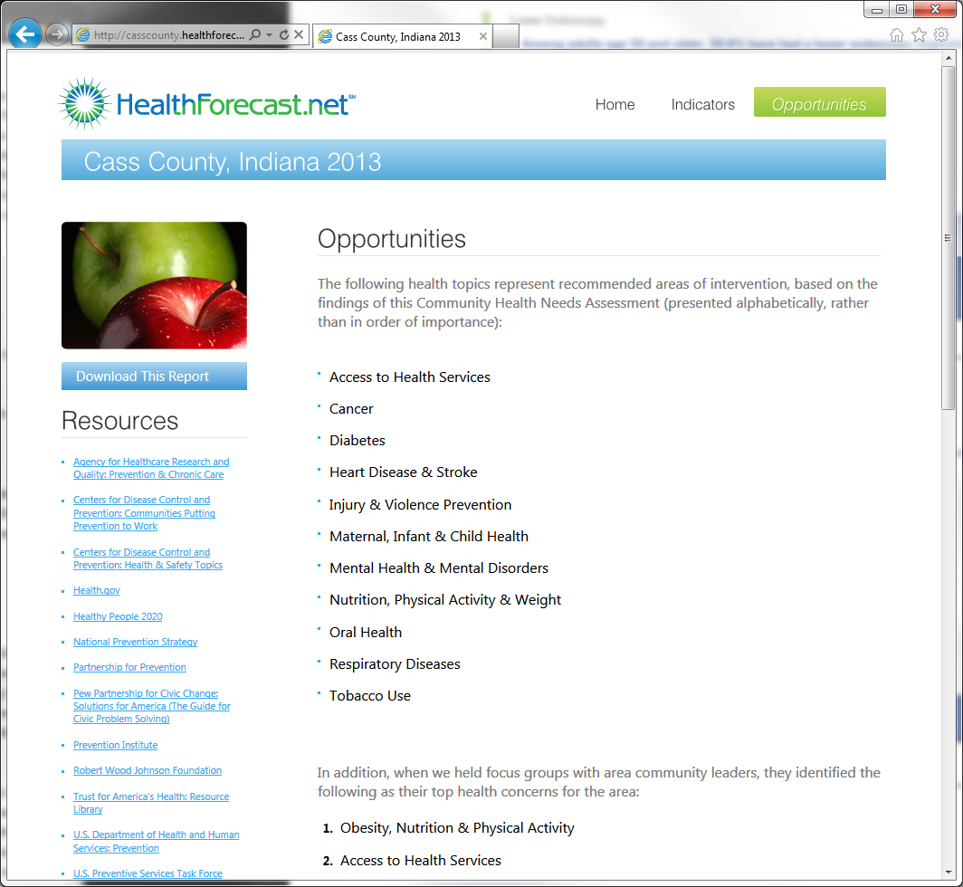
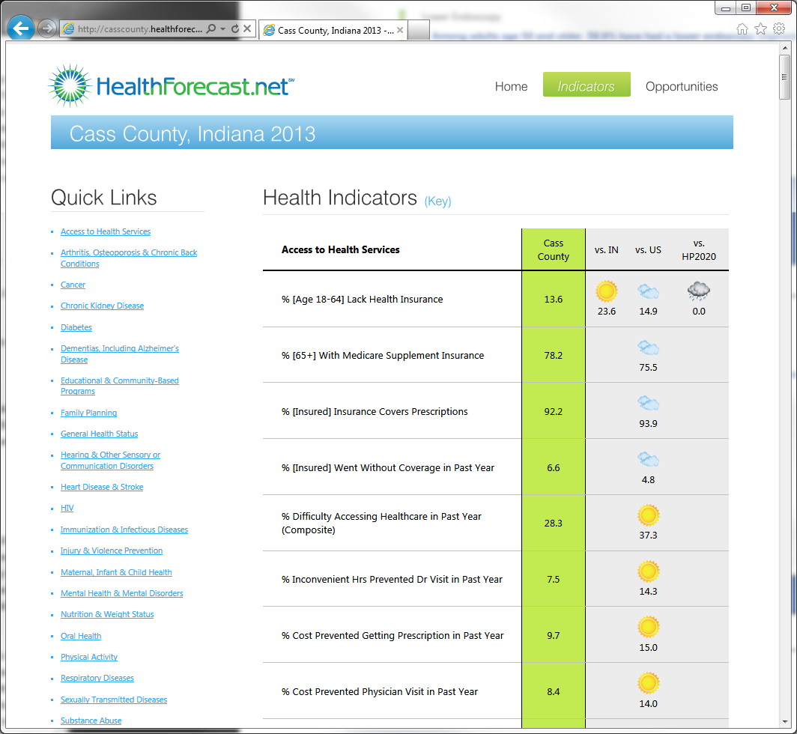
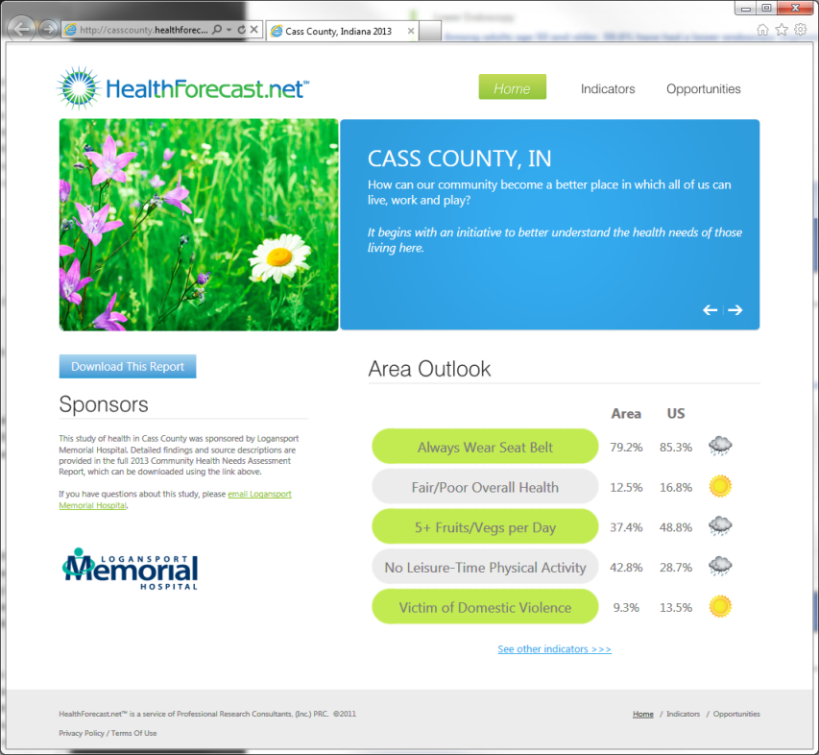
Public dissemination solution — HealthForecast.net™
User = casscounty
Password = chna
http://CassCounty.HealthForecast.net

Slide 57
Q&A
Areas of Opportunity
Access to Health Services
Cancer
Diabetes
Heart Disease & Stroke
Injury & Violence
Maternal, Infant & Child Health
Mental Health & Mental Disorders
Nutrition, Physical Activity & Weight
Oral Health
Respiratory Disease
Tobacco Use

